Slide 1
VHDL
VHDL is a powerful hardware description language
Used for both circuit synthesis (construction) and circuit simulation.
Synthesis (construction) -the language describes the desired behavior or structure of a digital unit, from which a compliant physical circuit is inferred by the compiler.
Simulation (testing) - generates stimuli and applies them to the designed (coded) circuit,
Main applications of VHDL include : synthesis of digital circuits onto (FPGA) chips and layout/mask generation for application specific integrated circuit (ASIC) fabrication plus corresponding functional and timing simulations.

Slide 2
VHDL
VHDL stands for VHSIC Hardware Description Language.
Resulted as part of the very high speed integrated circuits (VHSIC) initiative funded by the U.S. Department of Defense in the 1980s
Its first version was VHDL-87; it was later upgraded to VHDL-93, then to VHDL-2002, and finally to VHDL-2008.

Slide 3
Design Flow
1. RTL analysis and elaboration.
VHDL code is compiled independently of target device or technology.
The VHDL syntax is checked and the circuit schematic is generated.
The circuit can be simulated
Simulation at this level (RTL) is usually called behavioral simulation, which falls in the functional simulation category.
2. Synthesis
Simplification might occur, primitives are used,
A netlist, which is now device/technology dependent, is created

Slide 4
Design Flow
3. Implementation (Fitting)
The design is assigned to particular logic blocks inside the FPGA and routing is performed.
Both functional and timing simulations are again available.
4. Device Programming
2 files are generated for that purpose; Either method can be used.
One for direct programming – direct to the target FPGA.
Another for an external nonvolatile memory associated to the FPGA (for self-programming upon power up.

Slide 5
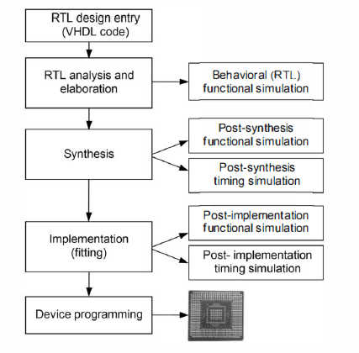
Typical design flow in FPGA-based projects

Slide 6
Commercial VHDL Tools
Some tools are offered by FPGA companies (like Altera-now Intel FPGA-and Xilinx), while others are offered by third-party software companies.
Some examples are listed below.
From Xilinx: Vivado (synthesis/implementation and simulation).
From Altera: Quartus Prime (synthesis/implementation and some simulation).
From Mentor Graphics: ModelSim (simulation), Questa (simulation), Precision RTL (synthesis). ModelSim is indeed the tool that implements the simulation part in Quartus Prime and, optionally, also in Vivado.
From Synopsys: Synplify Pro (synthesis).
From Aldec: Active-HDL (simulation), Riviera-Pro (simulation).

Slide 7
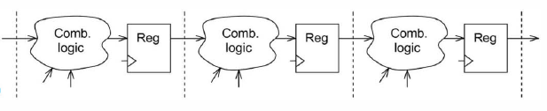
Register Transfer Level of Abstraction
"Register transfer level is a level of description of a digital design in which the clocked behavior of the design is expressly described in terms of data transfers between storage elements in sequential logic, which may be implied, and combinational logic, which may represent any computing or arithmetic-logic-unit logic. RTL modeling allows design hierarchy that represents a structural description of other RTL models.“- page 4 of the IEEE 1076.6 Standard for VHDL Register Transfer Level (RTL) Synthesis:

Slide 8
Concurrent versus Sequential Statements
VHDL statements are concurrent rather than sequential
Concurrency implies that the individual statements can be written in any order.
The only exceptions in VHDL are processes and subprograms, inside which the code is interpreted sequentially (as in regular computer programs).
purely concurrent code (i.e., without processes) is employed only to build combinational circuits, though for complex combinational circuits, the use of processes can be helpful.
For sequential circuits, processes are always needed

Slide 9

Lexical Elements of VHDL
Assignment symbols:
To assign a value to a Signal, the delimiter <= is employed
while assignments to variables, constants, and initial/default values employ the delimiter :=
Comments
A single-line comment starts with two hyphens (--) and extends up to the end of the line;
A delimited comment extends from /* up to */, in single or multiple lines.

Slide 10
Lexical Elements of VHDL
Bit and Bit String:
Single-bit binary values are written within single quotes
bit strings (bit vectors) are written within double quotes.

Slide 11

Lexical Elements of VHDL
Integers
Integers are written without quotation marks.
The type called integer in VHDL operates with up to 32 bits, ranging from 0 to 2^31 _ 1 if unsigned or from _2^31 to 2^31 _ 1 if Signed.
The underline character (_) can be used anywhere in the string to help visualize its value.

Slide 12

Lexical Elements of VHDL
Character and Character String
The synthesizable characters in VHDL are the 256 characters from the ISO 8859-1 (Latin-I) table, in which the initial 128 characters are from the ASCII table.
A single character is written in single quotes
A string of characters is written in double quotes.

Slide 13
Lexical Elements of VHDL
Identifiers
Identifiers are used to name VHDL items, like signals, variables, entity declarations, architecture bodies, package declarations
It can contain only letters (a to z, A to Z), decimal digits (0 to 9), and the underline character(_)
It must start with a letter;
It must not have two adjacent underline characters or end with an underline character;
It must be different from any of the reserved VHDL words
VHDL is not case sensitive
reset and RESET are considered the same name.
An exception is when a name is surrounded by backslashes (then called extended identifier); for example, \clk, \CLK, and \Clk are considered different names.

Slide 14
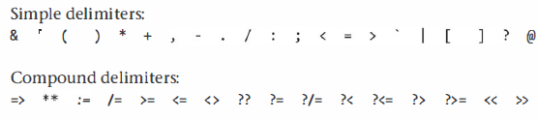
Lexical Elements of VHDL
Delimiters
Delimiters are used to mark the end of a statement or of a language construct, to represent operators, to enclose range specifications, and

Slide 15
Choosing Good Names for Your Design
Avoid Reserved VHDL words
Naming an Entity Declaration: usually also the name of the design as a whole
Naming an Architecture Body: architecture's name can be the same as the entity's name.
A common option is to use a name that indicates the abstraction level of the hardware description, like
behavioral (algorithmic kind of description
dataflow (Boolean kind of description, for combinational circuits),
rtl (collection of combinational blocks interconnected via registers),
structural (architecture constructed using component instantiations).
Naming Constants: By convention, only capital letters will be used for constant names, which as usual must be informative.

Slide 16
Choosing Good Names for Your Design
Naming an Signals and Variables: Well-established abbreviations are good. The use of Single-letter names, like x (for input) and y (for output), is fine only for simple cases.
Naming Functions and Procedures: When the function returns a numeric value, a good option is to name it based on the operation that it executes.
A typical way of naming a procedure is to start with a verb that represents its action,
Naming Types: base the new name on the base type’s name.
Naming Files: Save synthesizable VHDL code in a file with the same name as the code's entity declaration, with the extension .vhd.

Slide 17
Choosing Good Names for Your Design
Naming an Signals and Variables: Well-established abbreviations are good. The use of Single-letter names, like x (for input) and y (for output), is fine only for simple cases.
Naming Functions and Procedures: When the function returns a numeric value, a good option is to name it based on the operation that it executes.
A typical way of naming a procedure is to start with a verb that represents its action,
Naming Types: base the new name on the base type’s name.
Naming Files: Save synthesizable VHDL code in a file with the same name as the code's entity declaration, with the extension .vhd.

Slide 18
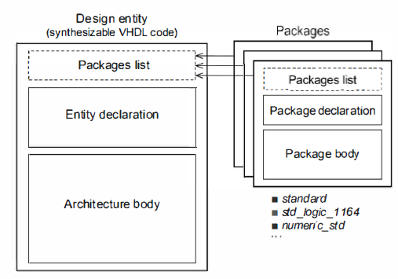
Code Structure and Composition

Slide 19
Libraries and Packages
The main official VHDL packages are distributed as either std or ieee.
Packages from the std library;
Package standard: Defines the standard types bit, bit_vector, integer, Boolean, character, and so on and a number of related operators plus other functions.
Package textio: For dealing with text and files.
Package env: For communication with the simulation environment
Packages from the ieee library
Package std_logic_1164: A very important package, which defines the nine-value type std_ulogic, along with its array version, the std_ulogic_vector type.
It also includes the related subtypes std_logic and std_logic_vector, respectively.
It also has the additional synthesizable values don’t care ( ' - ' ) and high-impedance ( ' Z ' ) (type bit only allows ‘0' and ‘1 ' ) .

Slide 20
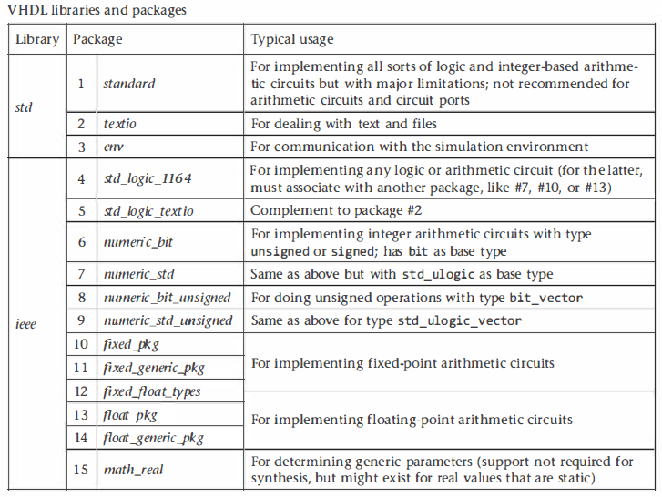
Libraries and Packages

Slide 21


Packages List in the Code
VHDL code starts with a list of all packages needed to process the design.
To make a package visible to the compiler, a library clause plus a use clause pointing to the specific package of that library are needed.
keyword all causes all elements of that package to be visible
The clauses that are introduced automatically (default) are the following:

Slide 22
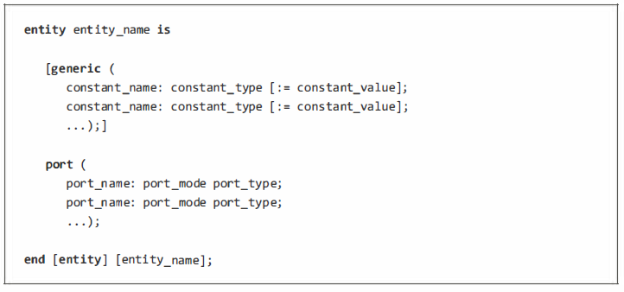
Entity Declaration
Remember that the entity name should be also the project name,

Slide 23
Entity Declaration
The declarative part can contain the same kinds o f declarations and specifications allowed in the declarative part of the architecture. except for component declarations and configuration specifications.
The statement part can contain concurrent assertion statements and passive procedure calls (these do not involve signal assignments and are used, for example, for testing port values in simulation) .

Slide 24
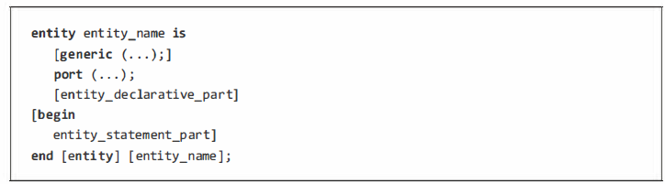
Entity Declaration
Generic List (Optional): used for declaring global constants
Port list: a list with specifications of all circuit inputs and outputs.
Port mode: which can be in, out, or inout
Port type, which can be any of the predefined VHDL types or user-defined types
Other entity regions: Though not used frequently;

Slide 25
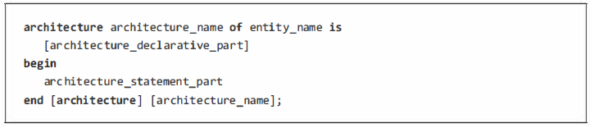
Architecture Body
Contains the VHDL code proper.
It is composed of two parts, the first being a declarative region and the second a statement region

Slide 26
Architecture Body
Declarative part: can contain declarations of subprogram (with subprogram body), package (with package body, if needed), type, subtype, constant, signal, shared variable, file, alias, component, attribute, and group.
It can also contain configuration and disconnection specifications plus use clauses. The most popular declarations are of types, signals, and constants.
Statement part: This region is where the VHDL statements (the code proper) are placed.
Here is where the circuits are built.

Slide 27
Object Classes
An object is a named item that has a value of a type.
There are four object classes in VHDL: constant, signal, variable, and file.
Constant:
Members of the constant class have a static value.
A constant can be declared (created) in the declarative part of entity, architecture, package, block, generate, process, or subprogram
A constant can be declared (created) in the declarative part of entity, architecture, package, block, generate, process, or subprogram

Slide 28
Object Classes
Why use constants:
It makes the code more readable because, it has a meaningful name.
It avoids the use of numeric values or related expressions inside the code, which can be messy.
it reduces the effort and, more importantly, prevents errors when the value of a constant must be modified,
Explicitly declared constant: A constant declared using the syntax above.
A deferred constant: declared without a value.

Slide 29
Object Classes
Signal
Signals represent wires.
Members of the signal class are capable of passing values in and out of the circuit as well as between its internal parts.
All elements of the port list of an entity declaration belong to this class
Signal declarations can be made in the declarative part of entity, architecture, package, block, and generate.
Signals cannot be declared in sequential code (i.e. process and subprograms), though their values can be modified there.
The type of a signal can be any valid VHDL type-either predefined or user defined.
The default value is optional

Slide 30
Object Classes
Variable
They do not represent wires (they can only do that indirectly, via signals)
They are used solely in sequential code.
A variable can be declared (created) only in the declarative region of a process or subprogram.
The type of a variable can be any valid VHDL type-either predefined or user defined.
The initial value is optional

Slide 31
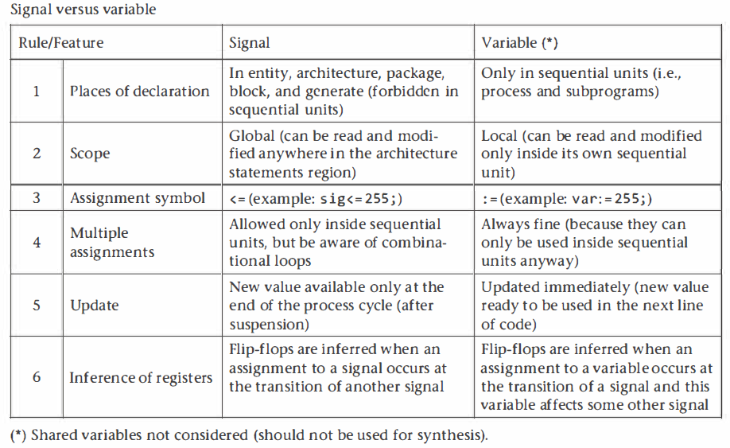
Signal versus Variable

Slide 32
Object Classes
File
This is not for synthesis but for simulation.
Covered in more detail later

Slide 33
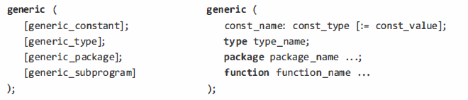
Generics
Generics are part of entity declarations.
It allows the construction of parameterized codes, improving code organization, readability, and reusability
A generic list should contain only the parameters that need to be modified for the circuit to have any desired size
What can go in a generic list: constants, types, packages, and subprograms.
Where can a generic list go: in entities (and components), packages, and subprograms.

Slide 34
Predefined Data Types
VHDL is said to be a strongly typed language.
It does not allow data transfer between objects of different types (even if the type declarations, except for the identifiers, are exactly the same);
It does not allow implicit type conversion;
Every operator is constructed for specific data types.
The subject of data types in VHDL, including both predefined and user-defined types, is relatively complex, but it is indispensable to understand it well to write code efficiently

Slide 35
Predefined Data Types
VHDL is said to be a strongly typed language.
It does not allow data transfer between objects of different types (even if the type declarations, except for the identifiers, are exactly the same);
It does not allow implicit type conversion;
Every operator is constructed for specific data types.
The subject of data types in VHDL, including both predefined and user-defined types, is relatively complex, but it is indispensable to understand it well to write code efficiently

Slide 36
Predefined Data Types
Typical uses of the predefined data types;
Standard types: (created in the package standard): for general internal use, though no longer frequent, except for boolean and integer (but the latter is not recommended to do arithmetic).
Standard-logic types: (created in the package std_logic_1 164): recommended for implementing logic circuits and for representing the ports of any (logic or arithmetic) circuit whenever possible.
Unsigned and signed types: (created in the package numeric_std): recommended for implementing arithmetic circuits that operate with integers.

Slide 37
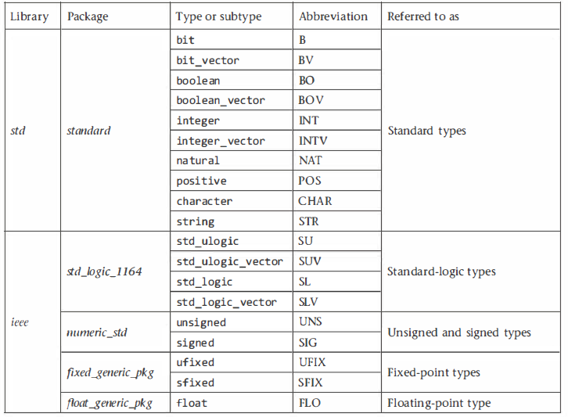
Predefined Data Types
Main synthesizable predefined types;

Slide 38
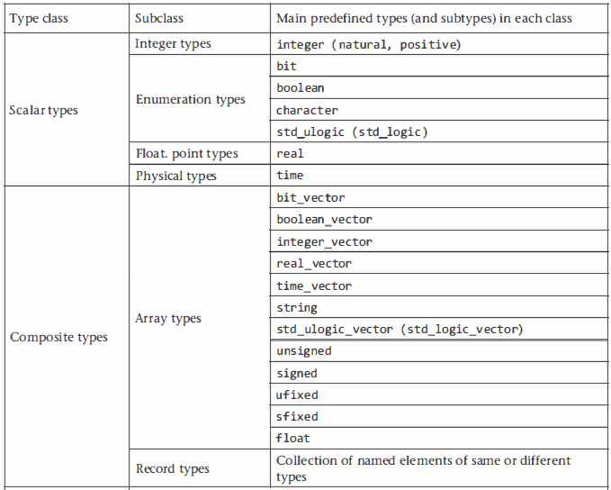
Type Classes
There are five official type classes in VHDL, called scalar, composite, file, access, and protected types.

Slide 39
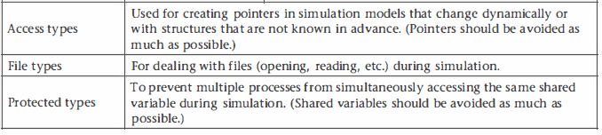
Type Classes
There are five official type classes in VHDL, called scalar, composite, file, access, and protected types.
The last three classes are also intended for simulation.

Slide 40
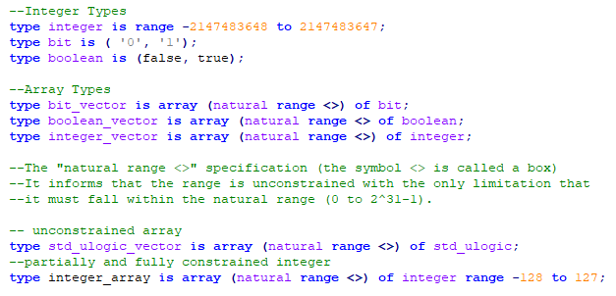
Type Declarations

Slide 41


Subtypes
A subtype is a type with some constraint.
Sometimes, instead of range constraints, a resolution function is employed in the subtypes
The advantages of declaring a subtype instead of a new type are that values can be passed directly between a subtype and its parent type and that a subtype inherits all properties (operators support, for example) of its parent type.

Slide 42

A Note on Operators and Attributes
VHDL provides a rich set of operators for the predefined data types. The main ones are:
However, none of the predefined data types have support for all of them.
To use the predefined types efficiently, it is indispensable to know what kind of support they have.

Slide 43
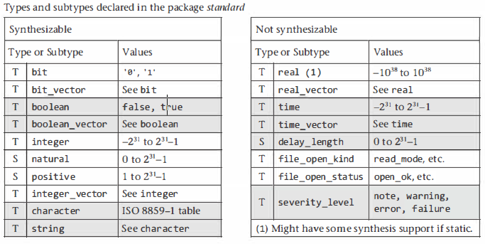
Study of Predefined Data Types

Slide 44
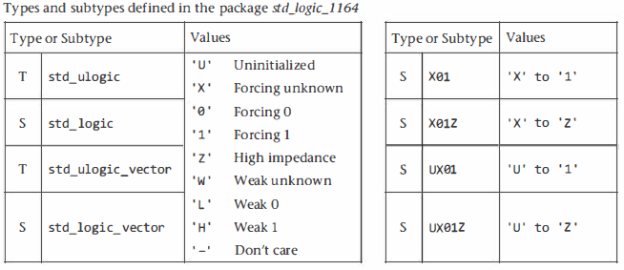
Study of Predefined Data Types
As a good design practice, values other than ‘ 0 ' , ' 1 ' , ' z ' , and ' - ' should not be used.
The standard-logic types are the most commonly used types in the industry

Slide 45
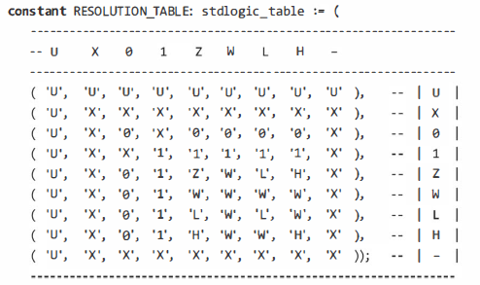
Resolution Table
Determines the resulting value when a signal is driven by multiple sources
The subtype std_logic is said to be a resolved version of the type std_ulogic because it is subject to the resolution table below:
the use of std_logic for synthesis is safe

Slide 46
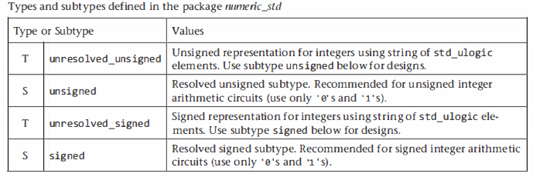
Unsigned and Signed Types
These types, having std_ulogic as base type, are defined in the package numeric_std.
Since these types are intended for arithmetic circuits, only logic values ‘0' and ‘1’ should be used.
Because in VHDL the leftmost bit is always the most significant bit (MSB), the use of descending index ending in zero is also recommended.

Slide 47
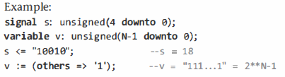
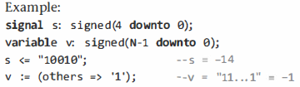
Unsigned and Signed Types

Slide 48
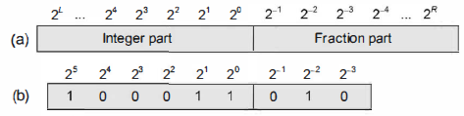
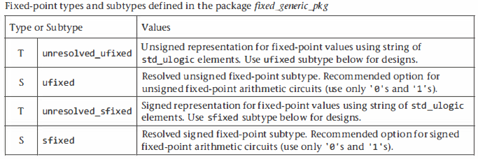
Fixed-Point Types
Fixed-point types and subtypes are defined in the package fixed_generic_pkg
They are intended for arithmetic circuits: only logic values ‘0‘ and ' 1' should be used
The range must always be descending, from L down to R, where L (left) is usually positive and R (right) is usually negative

Slide 49


Fixed-Point Types

Slide 50
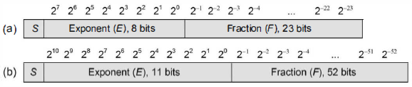
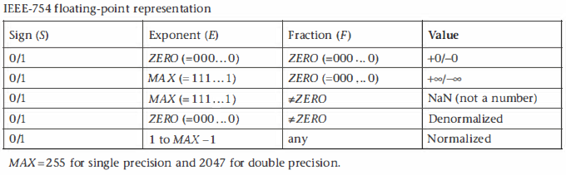
Floating-Point Arithmetic: The IEEE 754-2008 standard

Slide 51

Floating-Point Arithmetic: The IEEE 754-2008 standard
Floating-point to integer conversion
Integer to floating-point conversion

Slide 52
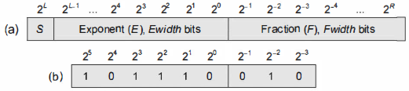
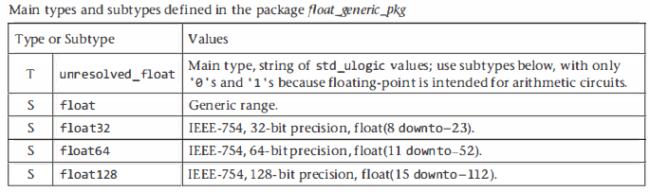
Floating-Point Types
Floating-point types and subtypes are defined in the package floating_generic_pkg
They are intended for arithmetic circuits, only logic values '0' and '1' should be used
They follow the IEEE 754 standard closely
The range must always be descending, from L down to R.

Slide 53



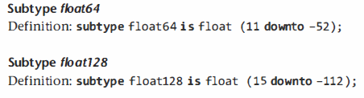
Floating-Point Types

Slide 54
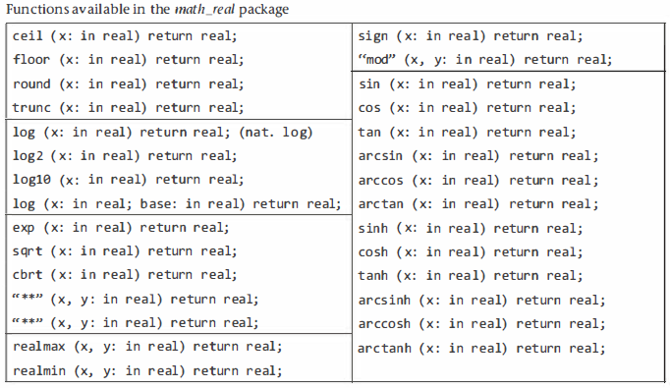
Type Real
Is not intended for synthesis
But it usually has some synthesis support for static values, so it can be helpful for defining general circuit parameters
The functions are available in the math_real package

Slide 55
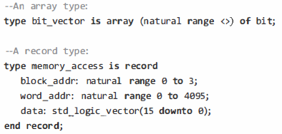
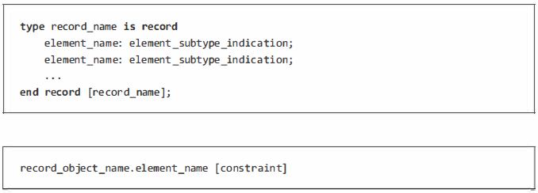
Record Types
Like arrays, it is a composite type but can have multiple members, with elements that may be of different types.

Slide 56
Access Types, File Types, and Protected Types
Access types are used to create pointers in simulation models that change dynamically or with structures that are not known in advance.
File types are used for dealing with files (opening, reading, etc.) during simulation.
Protected types are used to prevent that multiple processes access the same shared variable during simulation
All three are intended for simulation
While file types are needed (and are simple to use), the use of pointers and/or shared variables is confusing and error prone, so these should be avoided whenever possible

Slide 57
Page left Blank Intentionally

Slide 58
Concurrent Code
A circuit is said to be combinational when its output depends uniquely on its preset input, so the circuit has no clock or memory.
Purely concurrent VHDL code (i.e., without processes) is proper for implementing only combinational circuits.
The statements when, select, and generate are commonly used.
Many combinational circuits can be constructed without any formal statement thanks to the large collection of predefined operators (which are just function calls)

Slide 59
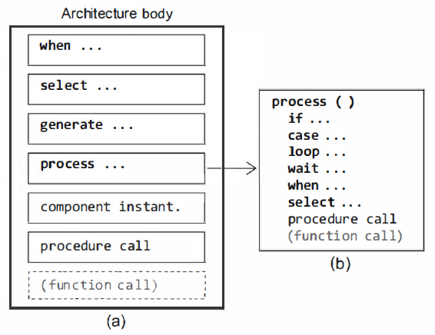
Concurrent Statements
The architecture body can be constructed with only concurrent statements (recall that VHDL is inherently concurrent rather than sequential),

Slide 60
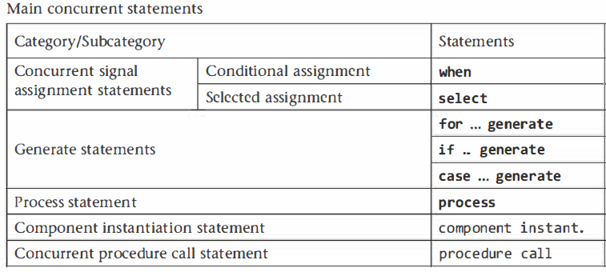
Concurrent Statements
A special statement in the list is the process statement.
Although as a whole it is concurrent with respect to all other statements, internally it is sequential, so only sequential statements can be used inside a process)
The formal designations for the concurrent statements of figure 1O.1a, according with the IEEE 1076 standard, are shown

Slide 61
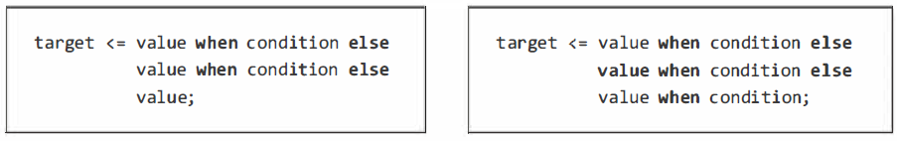
The when Statement
An assignment using the when statement is called a conditional assignment.
The target in the syntax above is a signal (VHDL-2008 allows when to be used also in sequential code, so there the target can be also a variable).
The value can range from a simple static value up to several values.
Any number of tests is allowed.
The when statement has a priority-encoding nature (for any given line to be executed, the tests in all preceding lines must return false)

Slide 62
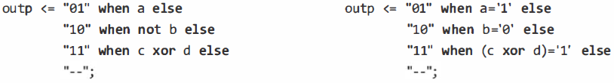
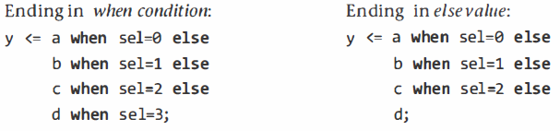
The when Statement
Example codes
The option on the left (ending with "when condition") is obviously more informative than that on the right (ending in "else value")

Slide 63
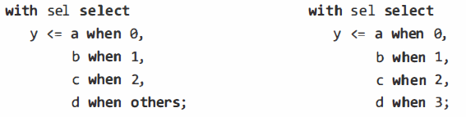
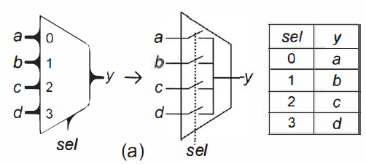
The select Statement
The target in the syntax above is a signal
The value can range from a simple static value to several values.
The example below shows an implementation for the multiplexer

Slide 64
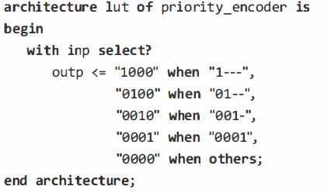
The select? Statement
The matching select statement (select?) employs the matching equality comparator (?=)
This statement is particularly useful when the truth table contains "don't care" values at the input
Observe also that the statement ends with "when others," so all truth table entries are covered, allowing select? to be synthesized.

Slide 65
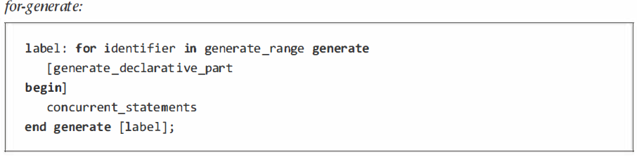
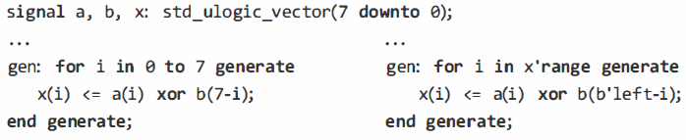
The generate Statement
There are three versions for this statement: for-generate, if-generate, and case-generate.
This is the most frequently used form of generate.
It acts as a loop, but because it is a concurrent statement, a piece of hardware is inferred every time the loop goes around.

Slide 66
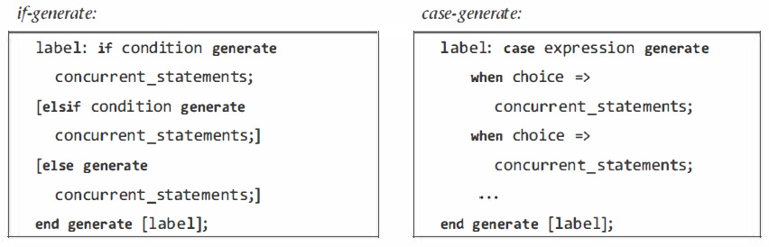
The generate Statement
There other two forms of generate are:
This is the most frequently used form of generate.
It acts as a loop, but because it is a concurrent statement, a piece of hardware is inferred every time the loop goes around.

Slide 67
Component Instantiation Statements
Are also concurrent statements, so they are not allowed in sequential units
A single instantiation can be done directly, but looped instantiations require the generate statement
A previous design (i.e., a complete VHDL code) can be instantiated as part of another design in two equivalent ways:
using a component instantiation
using a design entity instantiation.

Slide 68
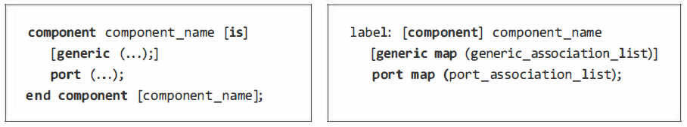
Component Instantiation
A component declaration plus a component instantiation statement are needed
The component declaration (on the above left) consists simply of a copy of the entity declaration of the design to be instantiated with the word entity replaced with the word component.
The component name is the same as its entity's name.
The typical location for this declaration is the declarative part of architecture, package, or generate statement
The component instantiation statement (right) provides the (possibly new) names and values for the generic parameters by means of generic map, and the port mapping between the instantiated design and the current design by means of port map.
The mapping associations can be named or positional;
If a port must be left unconnected in the instantiation, the keyword open should be used for it in the port map.

Slide 69
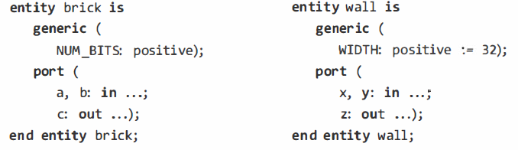
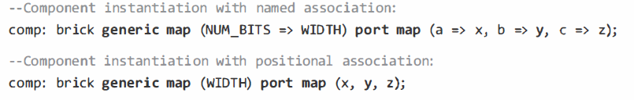
Component Instantiation
A component declaration plus a component instantiation statement are needed

Slide 70
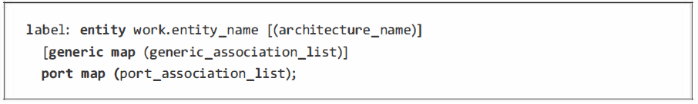
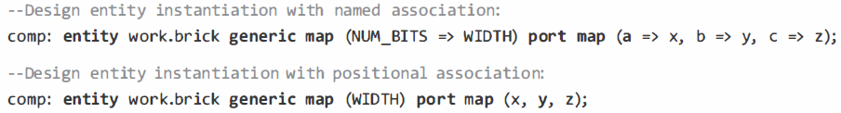
Design Entity Instantiation
This is another way of instantiating one design as part of another
An advantage here is that the component declaration is not needed
The work.entity_name declaration assumes that the entity_name.vhd file is present in the project directory

Slide 71
Page left Blank Intentionally

Slide 72
Sequential Code
Sequential code is needed to build sequential circuits, but it allows the construction of combinational circuits as well
Besides process, there are two other constructs in VHDL that are internally sequential, called function and procedure - collectively referred to as subprograms
The when and select statements have both concurrent and sequential versions.

Slide 73
Detecting Clock Transitions: clk'event or rising_edge(clk)?
Clock-edge detection (for the inference of registers) is an indispensable test in sequential circuits.
A clock transition can be detected using the event attribute directly.
The detection can also be done indirectly using the rising_edge or falling_edge function, which is constructed using the event attribute.
Even though both approaches above are fine for synthesis the latter (rising_edge and falling_edge functions) is preferred because it takes into account all std_ulogic values, which can be relevant for simulation or for synthesis of designs that employ the (nonrecommended) logic levels ‘L’ and ‘H’.

Slide 74
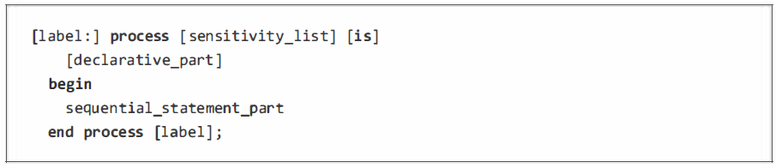
The Process Statement
A process as a whole is a concurrent statement, but internally it is a region of sequential code
Only sequential statements (if, case, loop, and wait, plus the sequential versions of when and select) are allowed inside it
The label in the syntax above is optional – for improving readability.
The sensitivity list is responsible for waking the process, causing it to execute, which occurs when any signal in the list changes
The end process keywords mart end of execution, but the actual suspension mechanism is an implicit wait statement located just before the end process keywords
If an explicit wait statement is used in the process, the sensitivity list is not allowed.

Slide 75
The Process Statement
The declarative part is optional - can contain declarations of type, subtypes …
It can also contain full subprograms, full packages, and use clauses.
Signal declarations are not allowed, while variable declarations are by far the most common.
The statement part of a process, which is where the circuit or a portion of it is actually built
It can contain only sequential statements and subprogram calls
An incorrectly filled sensitivity list should always be treated as a serious mistake

Slide 76
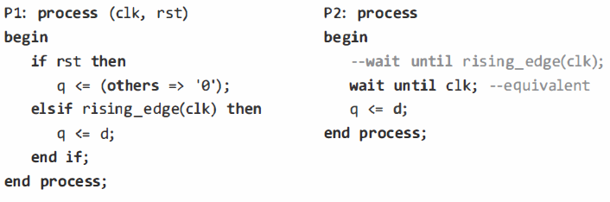
The Process Statement
Flip-flop inference Example – with and without sensitivity list

Slide 77
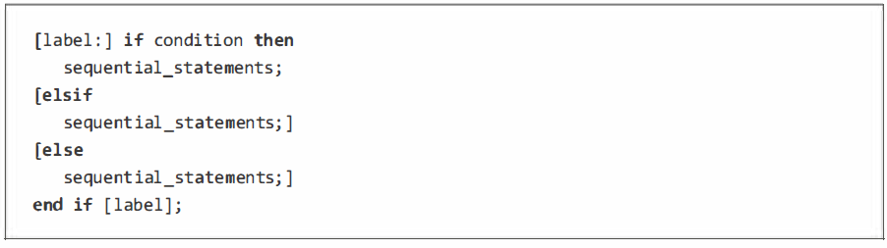
The if Statement
This is the sequential counterpart of the concurrent when statement,
Any number of elsif clauses is allowed.
It has the priority-encoding nature.
The reserved word unaffected or the null statement-both indicating that no action should take place-are allowed to be used with the if statement,

Slide 78
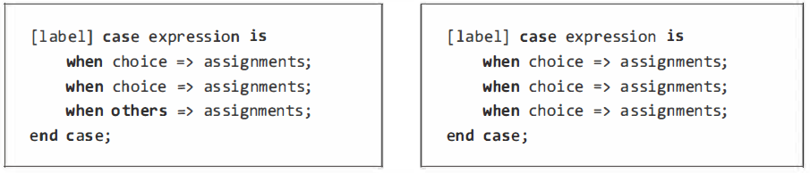

The case Statement
The case statement is the sequential counterpart of the concurrent select statement
Its main use is to enter straightforward truth tables, which case does better than if,
Does not posses the priority-encoding nature
Multiplexer example

Slide 79

The case? Statement
The matching case statement (case?) employs the matching equality comparator (?=).
It assumes the following for std_ulogic values: ‘0' =‘L’, '1’ = ‘H’, and '-' = any value.
Any other combination returns 'U' or 'X' or 'e‘.
This statement is particularly useful when the truth table contains "don't care" values at the input
Priority encoder example

Slide 80

The wait Statement
Recall that when an explicit wait is included in a process, the sensitivity list must be omitted.
It is available in four forms:
wait (unconditional),
wait until,
wait on, and
wait for (the first and last are for simulation).

Slide 81

The wait Statement
Examples

Slide 82


The loop Statement
Used when a section of code must be repeated several times.
There are five versions for the loop statement: unconditional loop, while-loop, for-loop, loop with exit, and loop with next.

Slide 83


The loop Statement

Slide 84

The Sequential when and select Statements
VHDL-2008 added sequential versions of when and select statements, which originally had only the concurrent versions
Their syntaxes and properties are the same as in concorruent.
Example: most compact implementation of DFFs.

